Slide 1

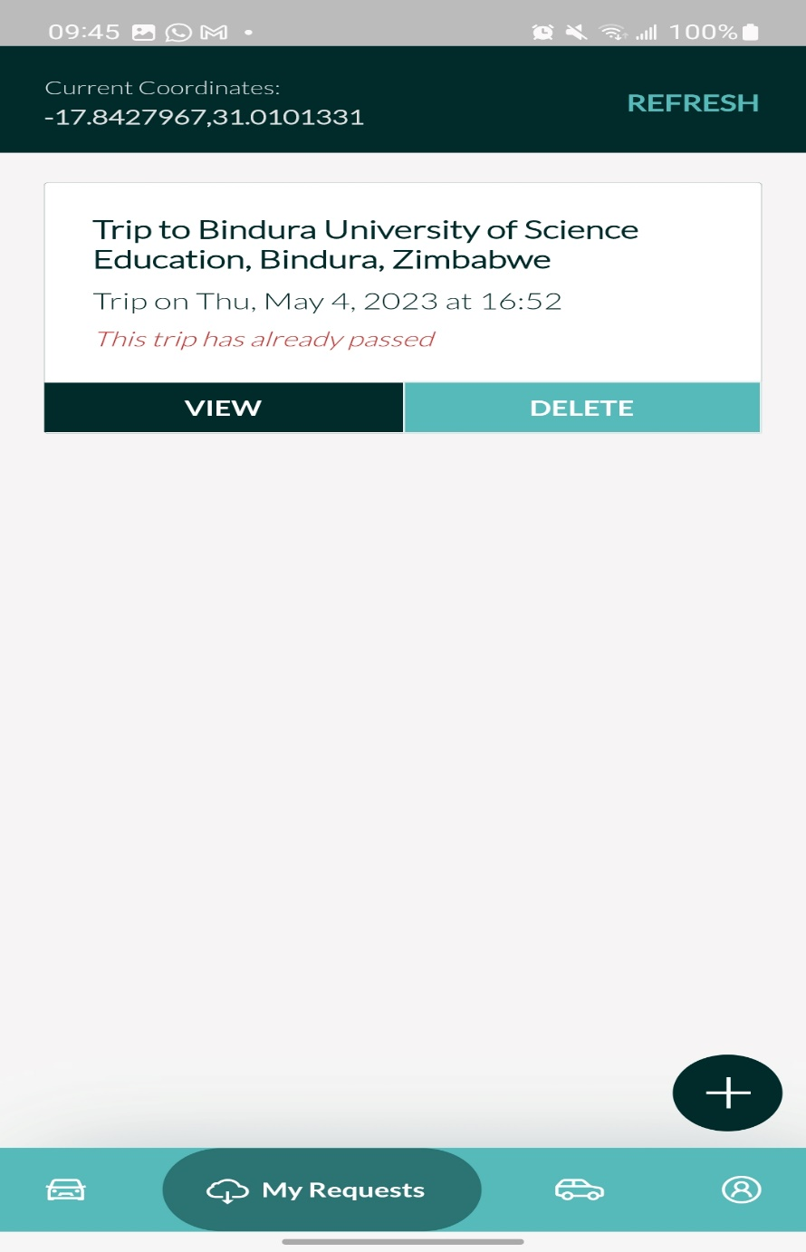
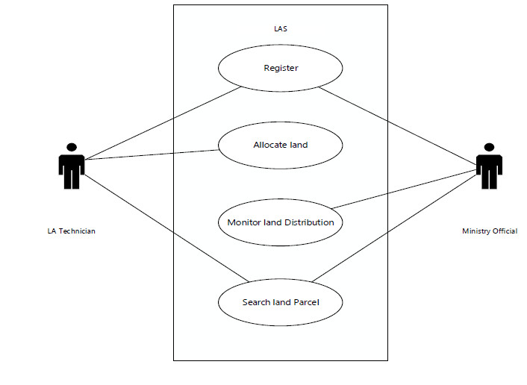
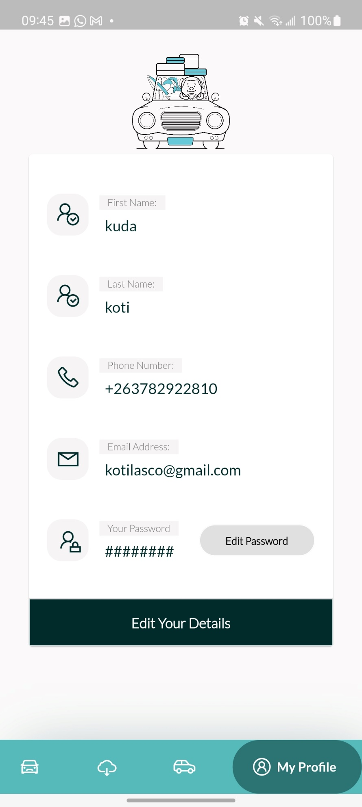
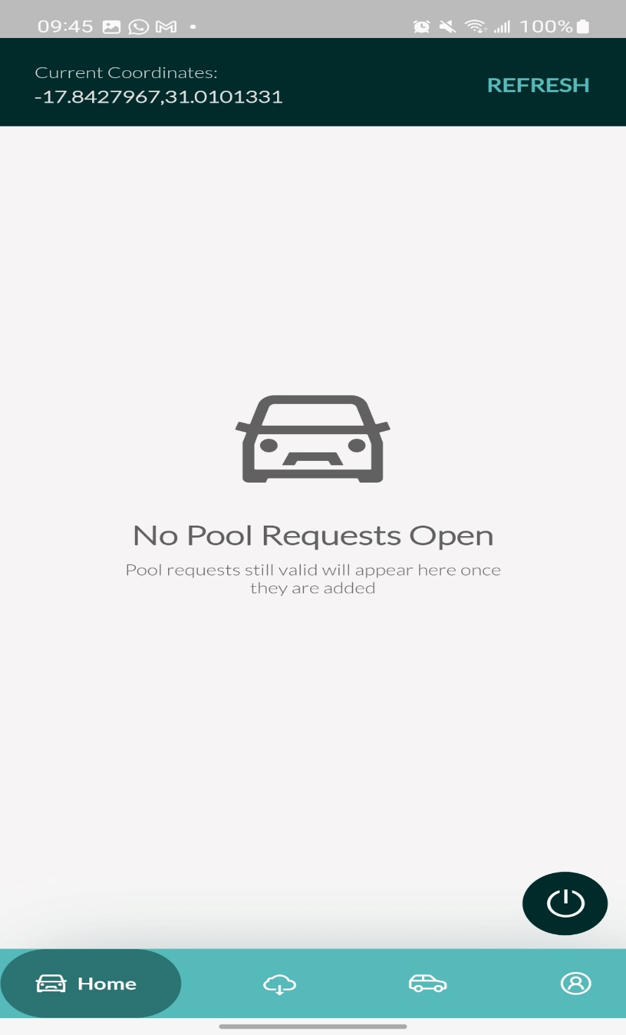
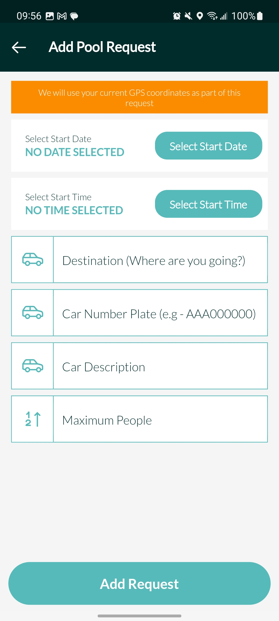
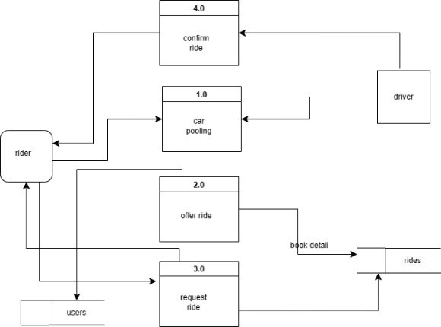
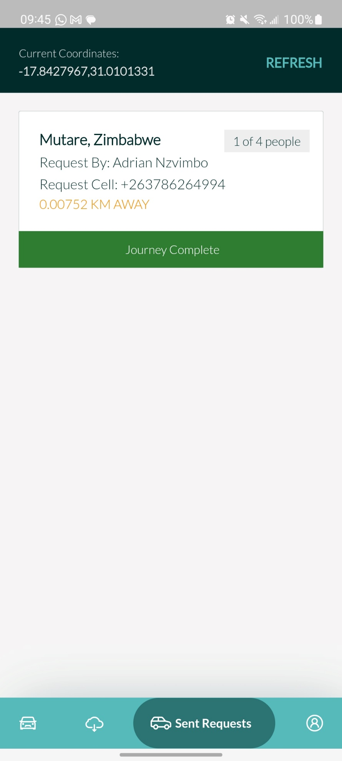
DECENTRALIZED CARPOOL
Kudakwashe Exstaff Koti - Software Engineering Department
1.0 Abstract
7.0. Use Case Diagram
Existing carpooling optimization techniques based on a centralized approach serve policy makers' goals but neglect the reality of participants. Moreover, without strict enforcement, participants often ignore centralized solutions and maximize their own savings. We present a new heuristic, formulated and tested on real and simulated carpooling problem cases, that mimics the decentralized carpool self-organization process. Our findings reveal system-wide savings similar to centralized models and a potential strategy for improving carpooling use. Decentralized ridesharing is a system in which individuals can arrange rides with each other without the need for a centralized organization or platform. Instead, participants use a peer-to-peer network to connect with other riders or drivers traveling in the same direction. This system enables more efficient use of resources, reduces traffic congestion and carbon emissions, and provides a more affordable alternative to traditional modes of transportation. The decentralized nature of the system also provides greater flexibility and autonomy for participants to arrange rides on their own terms without relying on a third-party platform or service. Overall, decentralized ridesharing has the potential to change the way we think about transportation and contribute to a more sustainable and equitable future. The system proposed by this study combines route customization, i.e seamlessly integrated with GPS, Google Maps, Android mobile app and Firebase database.
Carpooling entails two or more passengers traveling in the same direction in a private car along a partially shared route. The idea of carpooling is that some individual passengers' journey time is sacrificed in order to receive additional benefits such as sharing driving costs, parking fees, reduced traffic congestion, or lower carbon emissions. Unfortunately providing carpooling with general systems to users brings a lot of security flaws, first of all is overall stability of service. So decentralization will add transparency and ensures data protection as it is termed an unchangeable method
4.0. Overview of the developed application
We now realize that mobile technology is a broad and deep subject to master, that there are multiple ways to leverage it, and that app development is challenging and requires extensive planning and optimization. Decentralized carpooling is an effective way to reduce air pollution, parking problems, fuel consumption, commuting costs based on shared use of private cars or vehicles, mismanagement of user data, and also to increase the transparency of the system. In this paper, we study the carpooling problem and develop a decentralized carpooling prototype to implement ridesharing on the smartphone platform and Google Map API. Our proposed decentralized mobile ridesharing app aims to generate a simple ridesharing app that can help passengers and drivers and ensure no privacy violations. Finally, and after understanding the mobile technologies and solutions available for use, and understanding how car sharing work, we can determine the best options to use to build our app.
8.0. Screenshots
Conclusion
2.0. Introduction
This system uses Google Maps services and a GPS module to create user-specific services. It eventually leads to the construction of a well-organized transportation facility. It is a program targeted at lowering fuel usage and carbon emissions. As a result, it is an environmentally beneficial application. The primary goal of this study is to present the preliminary prototype of the suggested system. We now realize that mobile technology is a broad and deep subject to master, that there are multiple ways to leverage it, and that app development is challenging and requires extensive planning and optimization. Decentralized carpooling is an effective way to reduce air pollution, parking problems, fuel consumption, commuting costs based on shared use of private cars or vehicles, mismanagement of user data, and also to increase the transparency of the system. In this paper, we study the carpooling problem and develop a decentralized carpooling prototype to implement ridesharing on the smartphone platform and Google Map API. Our proposed decentralized mobile ridesharing app aims to generate a simple ridesharing app that can help passengers and drivers and ensure no privacy violations. Finally, and after understanding the mobile technologies and solutions available for use, and understanding how car sharing work, we can determine the best options to use to build our app
The car-sharing market is constantly growing and recently it has become popular more than car ownership. This classic car sharing system is based on a centralized database server which can often lead to hacker attacks or password leaks. Moreover, in a classic car-sharing system the owners of the car can misuse customers’ data. Nowadays we have come to see from a lot of use cases, that the best solution is to use blockchain technology. The blockchain technology is decentralized, immutable, public ledger provides the customers with security that is impossible to tamper with. The aim of the proposed system is to create and implement peer-to-peer short term car-sharing application that is based on decentralized just like the blockchain technology.
5.0. Objectives
To create a decentralized android application where people will find car owners using the same routes as they are.
To use google maps to get current location for a user
To include notifications which will alert car pooler
6.0. System Overview
3.0. Problem definition
Lately there is a problem of traffic on our roads and therefore the increasing fuel costs boost the misery of daily users of private vehicles. The number of vehicles plying on the road is rising as each day passes due to the low-cost cheap imports from Japan. This gives rise to few prime factors that square measure pollution, depletion and rising rates of fossil fuels and massive traffic congestion. The current system well known as mushika shika has been deemed illegal, with touts being suspected of rowdy behavior which has resulted in the inconvenience of travelers. Other solutions at hand include taxi management system, in this system the taxi driver, passenger and management system are important entities. These components interact with one other in existing taxi management systems.
Chibaya Yolanda

